Slide 1
Celonis Exercise Solution
Exercise Sheet 1: Process Explorer

Slide 2
Exercise 1 Overview
In this task, we want to get familiar with the Process Explorer.
Firstly, follow the instructions from the Introduction to Celonis presentation to upload the given (reduced) financial event log of a real-world loan application process¹ in Celonis and get familiar with the tools provided by Celonis Studio.
Next, use the Process Explorer component to investigate the process as instructed in the assignment.
¹Adapted dataset (with the 612 most frequent variants) from: van Dongen, Boudewijn (2012): BPI Challenge 2012. Version 1. 4TU.ResearchData. dataset.
https://doi.org/10.4121/uuid:3926db30-f712-4394-aebc-75976070e91f

Slide 3
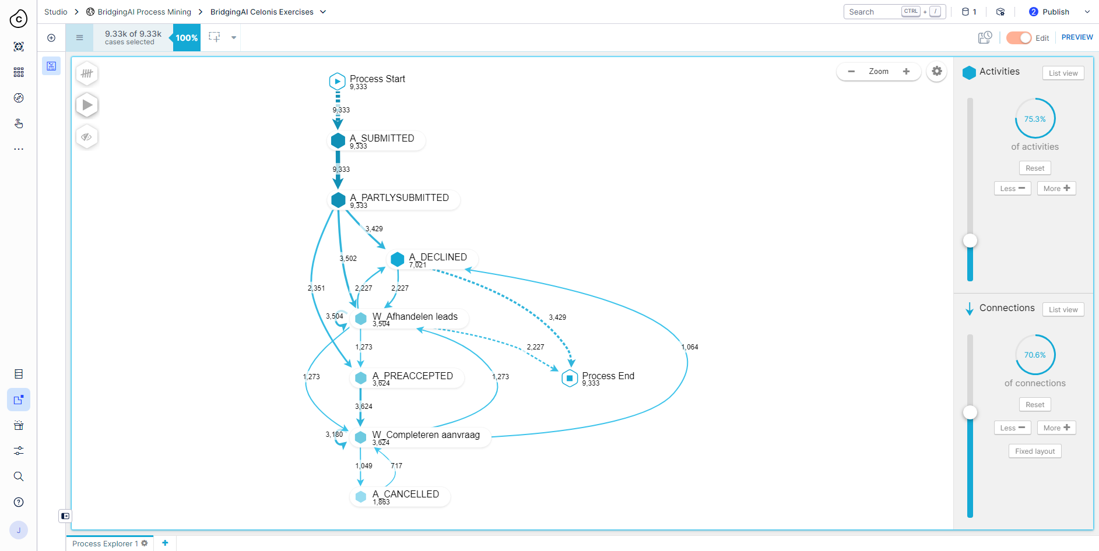
Solution - Exercise 1
Solution 1.a) Use the sliders to the right to display the DFG for the 75,3% most common activities and 70,6% most common connections.

Slide 4
Solution - Exercise 1
Solution 1.b) The numbers on the arcs represent the number of cases that contain the respective transition between activities. The numbers on the nodes show how many cases contain the activity.
Solution 1.c) In the full DFG, all activities and connections are included. As Celonis adds the “Process Start” and “Process End” activities artificially to every case, their frequencies correspond to the number of cases in the log. Thus, in the full DFG, the frequency of ingoing arcs to “Process End” should sum up to the number of cases in the log, which is equal to the the number on the node “Process End”.

Slide 5
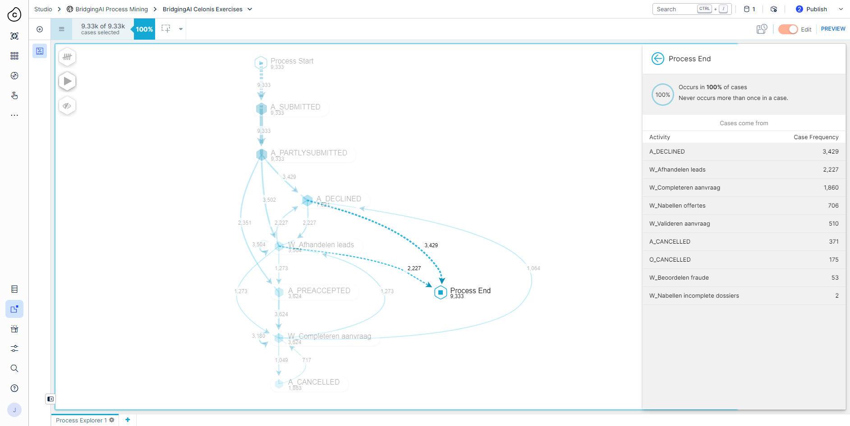
Solution - Exercise 1
Solution 1.d) To make the relation of the previous exercise hold, we want the DFG to contain all final activities of any case in the log. The easiest way is to click the node “Process End” in the Process Explorer. Here, we see all final activities of the event log. Thus, we need to increase the number of included activities until all of the listed activities are included.

Slide 6
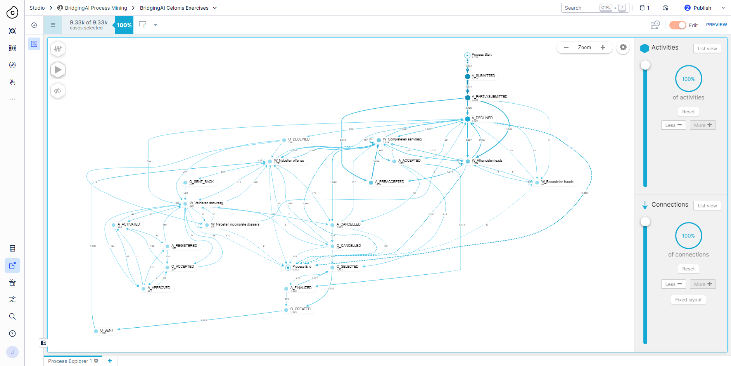
Solution - Exercise 1
Solution 1.d) As two cases end with the activity “W_Nabellen incomplete dossiers”, which is the least frequent activity of the event log, we need to include all 100% of activities. To also include the respective transition (“W_Nabellen incomplete dossiers” as final activity of a case), which is the least frequent in the entire log with only two occurrences, we also have to include all 100% connections resulting in this very confusing spaghetti model.

Slide 7
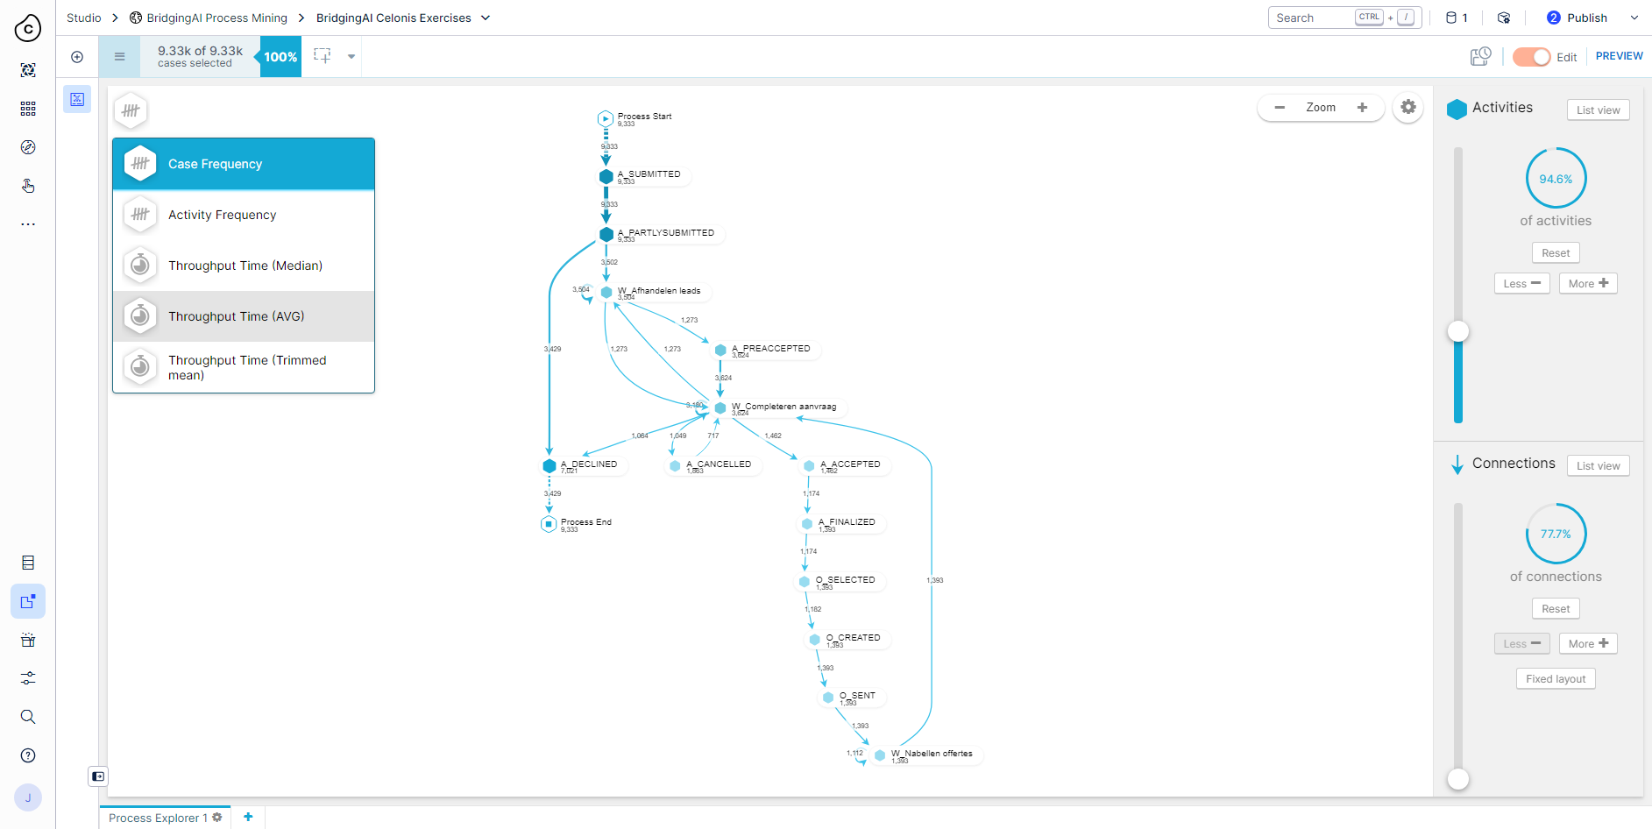
Solution - Exercise 1
Solution 1.e) The throughput times can be selected on the top left corner instead of case frequency labels. Afterwards, you can also choose the respective time units (days, hours, or minutes).

Slide 8
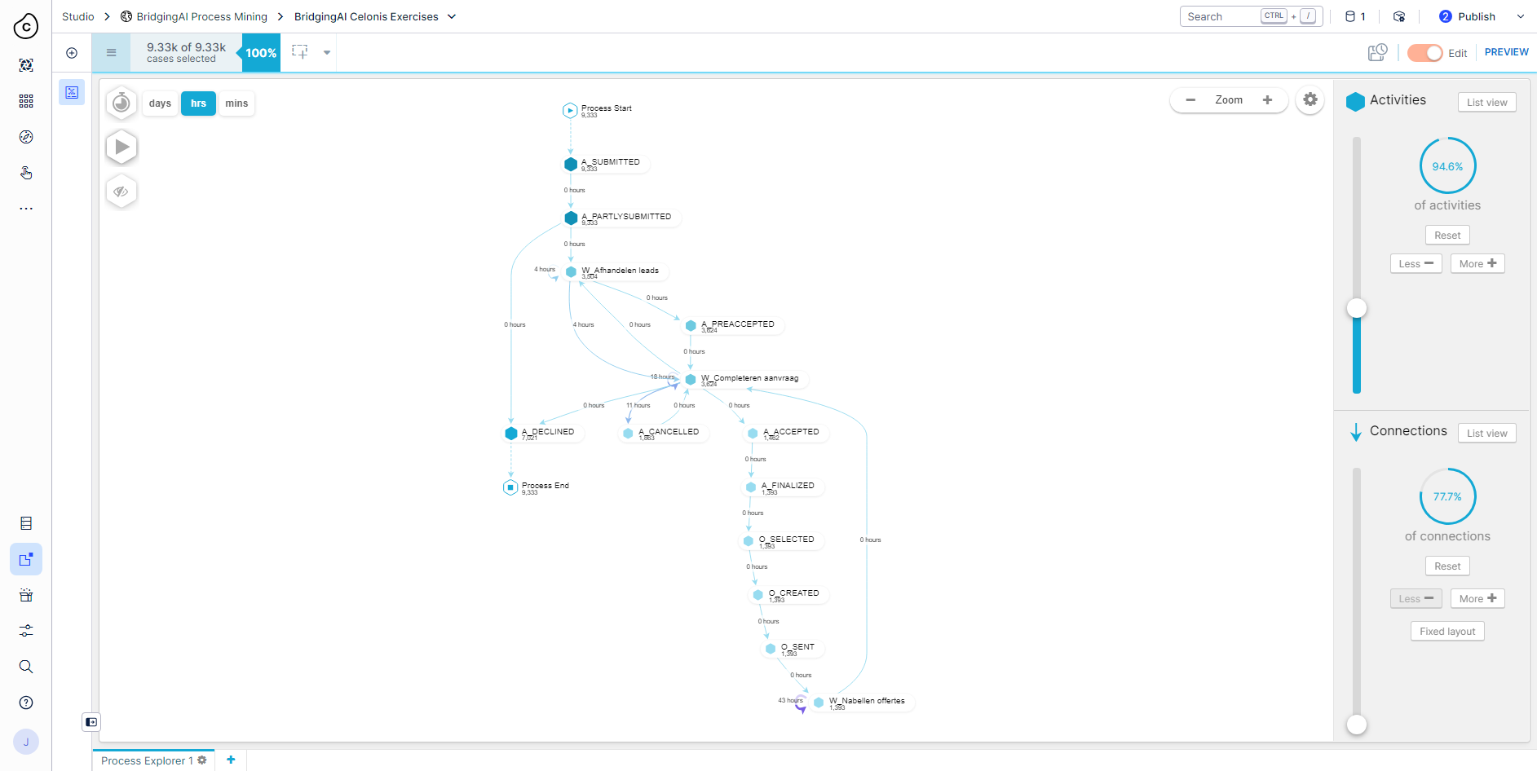
Solution - Exercise 1
Solution 1.f) The longest average throughput time between two activities is between two consecutive occurrences of “W_Nabellen offertes” with 43 hours.

Slide 9
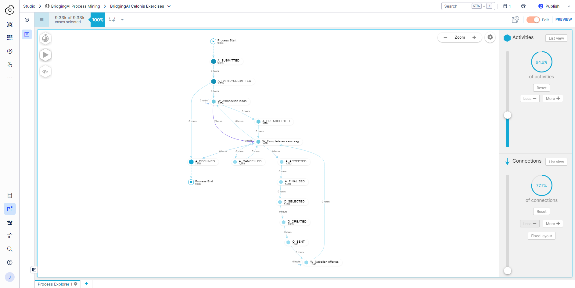
Solution - Exercise 1
Solution 1.f) The median throughput time of the respective transition corresponds to 0 hours. The deviation might occur due to some very long outlier throughput times that increase the average throughput time, but are not considered by the median.

